Slide 1

A Project Review Meeting on Shopping Cart & Checkout Flow
By
Name: Dhanush roll: 2520030014
Name: Pranav roll:2520030555
Name: Siddarth roll:2520090187
Team Number: 26
Under the guidance of
Ms. D.Pavithra
Assistant Professor
Department of Computer Science and Engineering
Koneru Lakshmaiah Education Foundation (Deemed to be University estd. u/s. 3 of the UGC Act, 1956) Off-Campus: Bachupally-Gandimaisamma Road, Bowrampet, Hyderabad, Telangana - 500 043. Phone No: 7815926816, www.klh.edu.in

Slide 2
Outline of the Presentation
Abstract
Introduction
Problem Statement
Project Flow Diagram
Objectives with Justification
Modules[Frontend web pages]
Expected Outcomes of the Proposed Work
Conclusion
References

Slide 3
Abstract
This project is a Smart Shopping Cart and Checkout Web Application developed using React, Vite, Tailwind CSS, Node.js, and Express. The main aim of the project is to provide users with a smooth online shopping experience by integrating key e-commerce features such as cart management, wishlist management, product comparison, checkout flow, authentication, and order tracking. The cart module allows users to add products, update quantities, remove items, save products for later, restore removed items, and view the total cart value. It also includes smart features such as cart expiry tracking, price lock, cart health score, budget limit, and cart activity timeline, helping users manage their shopping decisions more efficiently.
The wishlist module enables users to save products for future purchase, while the compare module allows users to compare multiple products based on details such as price, category, rating, stock, and features before making a purchase decision. The application uses React Context API to manage cart, wishlist, compare, checkout, authentication, and theme states across the frontend. API communication is handled using Axios, while the backend is built with Express.js and stores data in JSON files. Overall, this project demonstrates the design and development of a modern e-commerce system with a strong focus on user interaction, state management, reusable components, and efficient shopping workflows

Slide 4
Introduction
Online shopping applications have become an important part of modern digital commerce. Users expect a simple, fast, and reliable platform where they can browse products, save items, compare products, manage their cart, and complete purchases easily. This project, Smart Shopping Cart and Checkout Web Application, is designed to provide these essential e-commerce features in a user-friendly way.
The application is developed using React, Vite, Tailwind CSS, Node.js, and Express. It includes major modules such as cart management, wishlist, product comparison, checkout, authentication, and order tracking. The cart helps users manage selected products, the wishlist allows them to save products for later, and the compare feature supports better purchase decisions. Overall, this project demonstrates how a modern e-commerce application can be built using reusable components, state management, API integration, and a structured frontend-backend architecture.
.

Slide 5
Problem Statement
Modern e-commerce platforms often struggle with fragmented user experiences and security vulnerabilities during the checkout process. Client-side state management frequently leads to data loss during multi-step journeys, resulting in high cart abandonment rates. Furthermore, relying on the frontend for price calculations and discount validation exposes applications to malicious manipulation, compromising financial integrity.
There is a critical need for a scalable, highly synchronized checkout architecture that ensures seamless data persistence across complex user flows while centralizing sensitive business logic on the backend to guarantee secure, tamper-proof transactions.

Slide 6
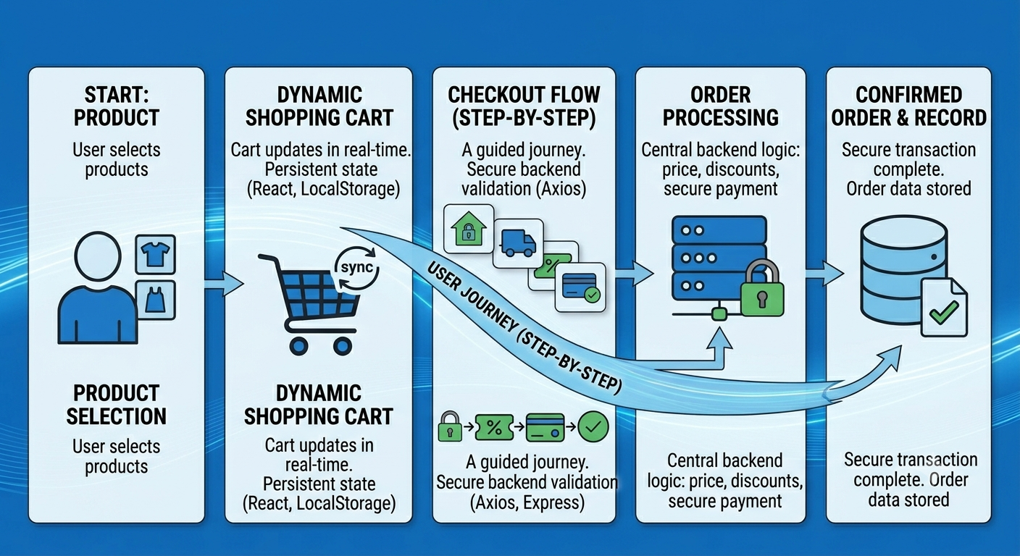
Project Flow Diagram

Slide 7
Objectives with Justification
Secure Pricing & Revenue Protection:
All price calculations and coupon validations are handled on the Express.js backend to prevent client-side tampering and guarantee financial integrity.
Persistent User Data:
React Context API and LocalStorage save user progress across the 10-module journey, ensuring cart and address details aren't lost during page refreshes, reducing checkout abandonment.
Instant Data Synchronization:
Axios manages real-time, asynchronous updates between the frontend and backend, providing users with immediate feedback on dynamic totals without disrupting the flow with full page reloads.
Modular & Scalable Design:
The entire checkout system is broken down into independent, reusable React components, simplifying debugging and allowing future features or payment methods to be added effortlessly.
End-to-End Lifecycle Tracking:
The application monitors the entire order journey from product selection to final confirmation, making it easy to log system errors and pinpoint exactly where users drop off.

Slide 8
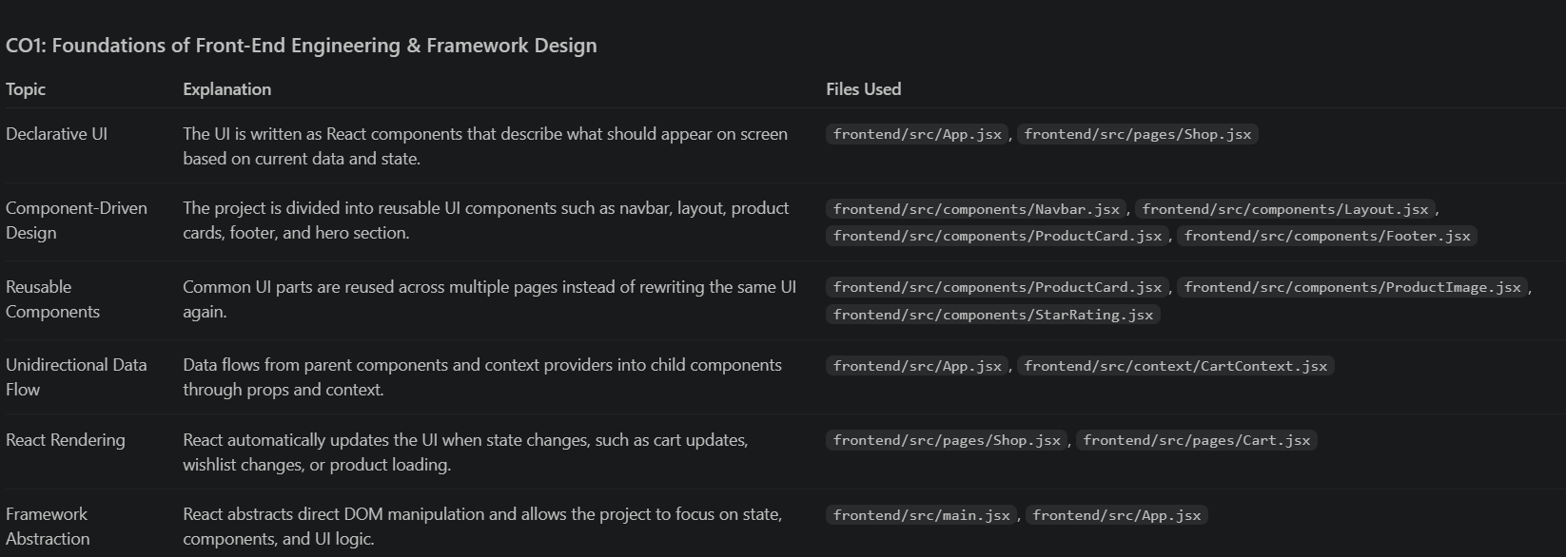
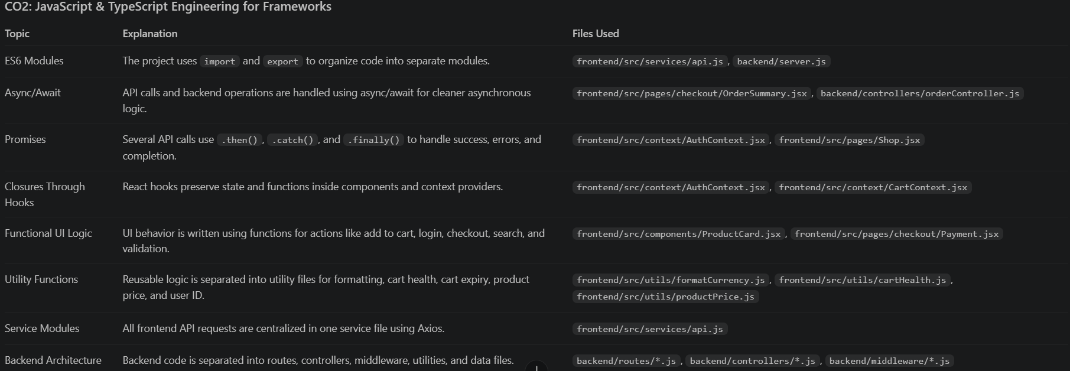
Modules-1 & 2

Slide 9
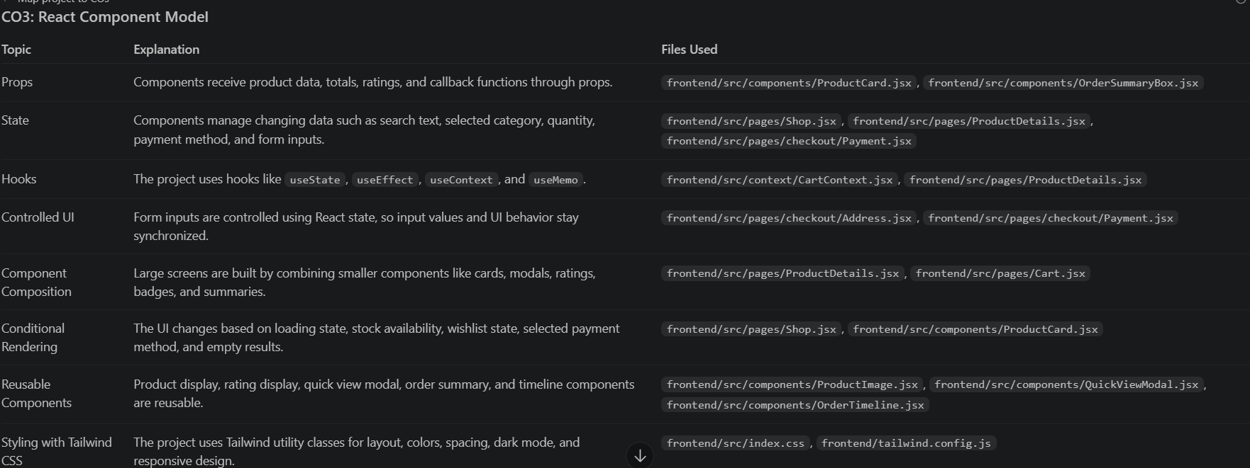
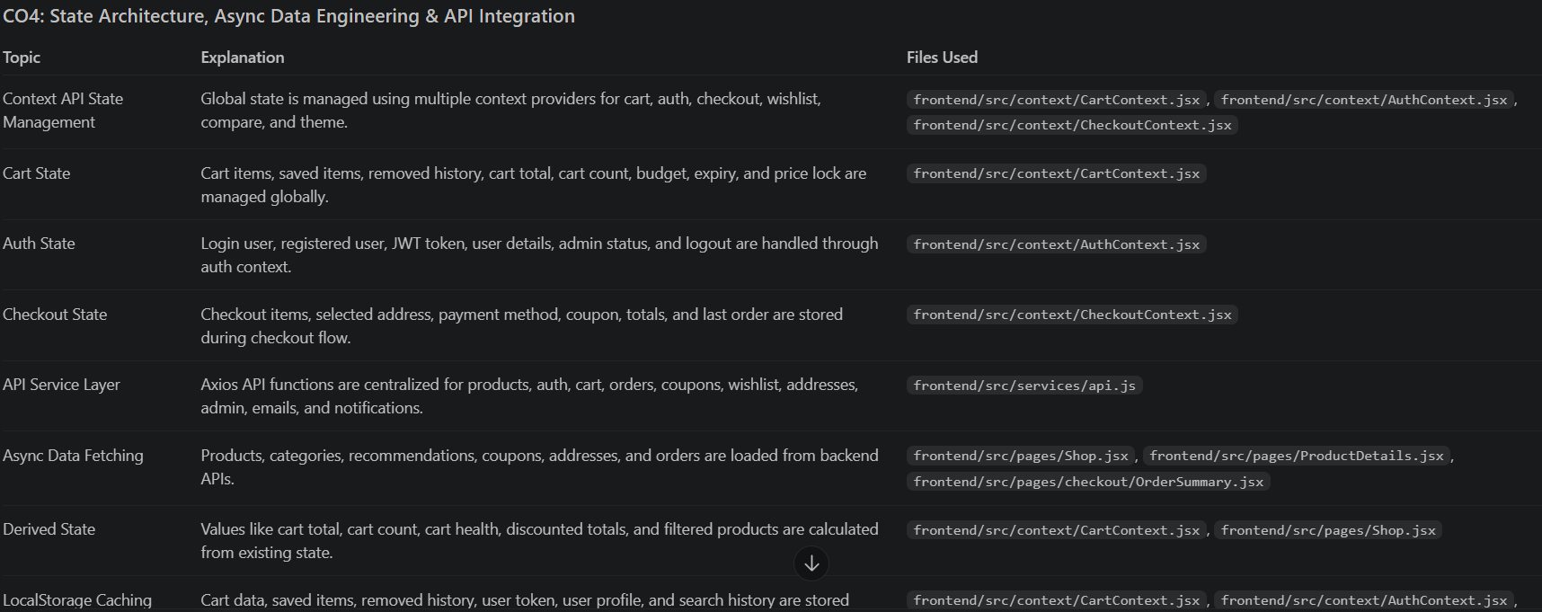
Modules-3 & 4

Slide 10
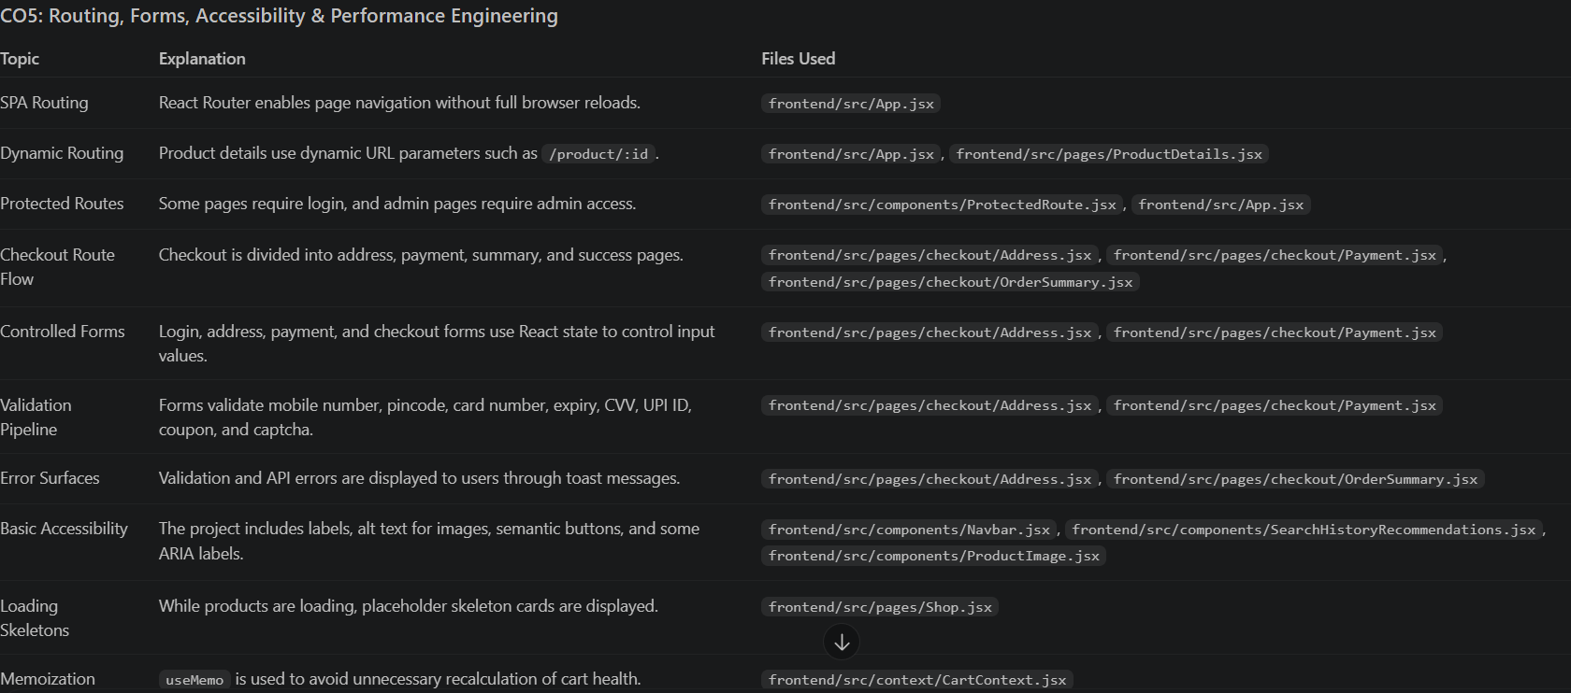
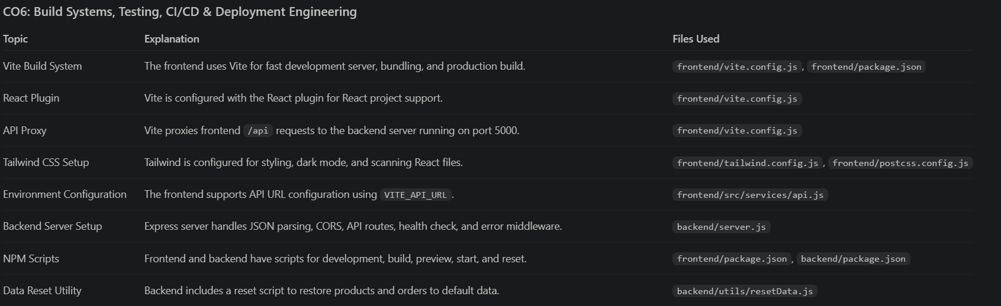
Modules-5 & 6

Slide 11
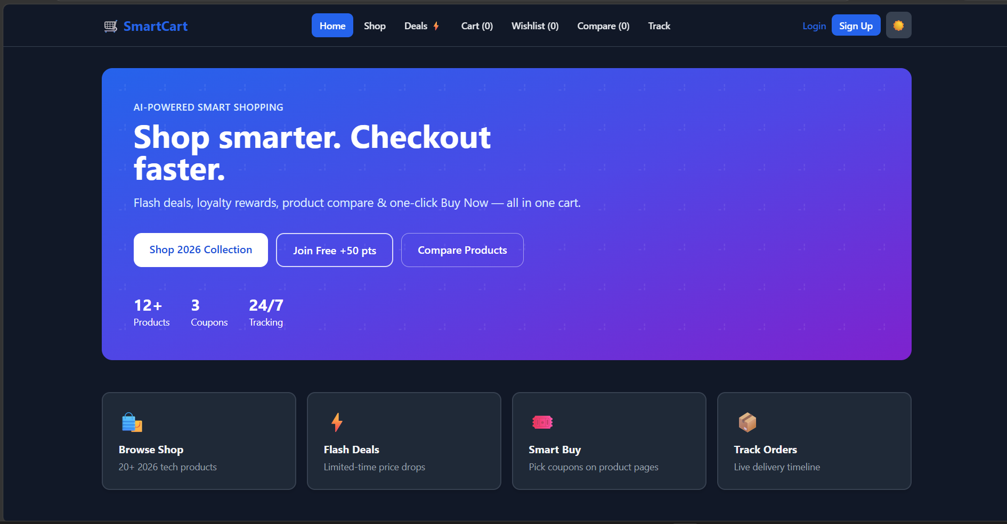
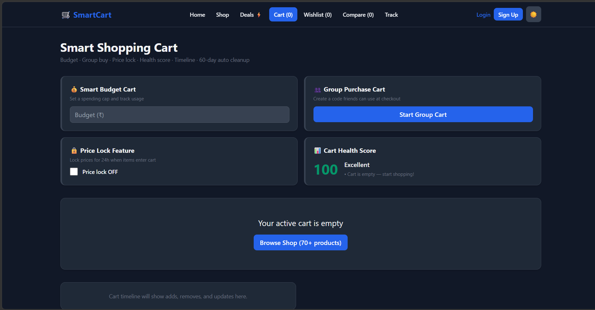
Expected Outcomes of the Proposed Work

Slide 12
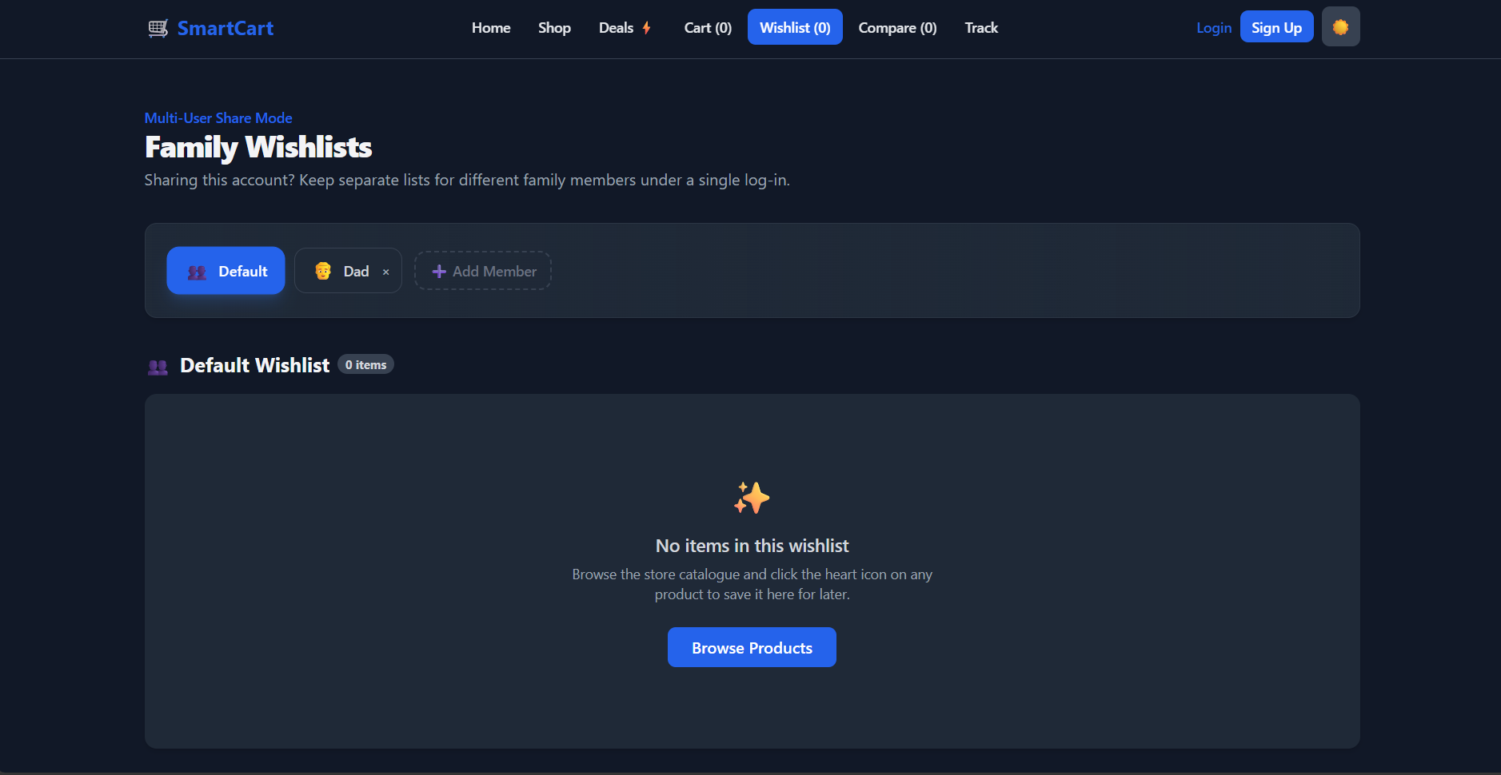
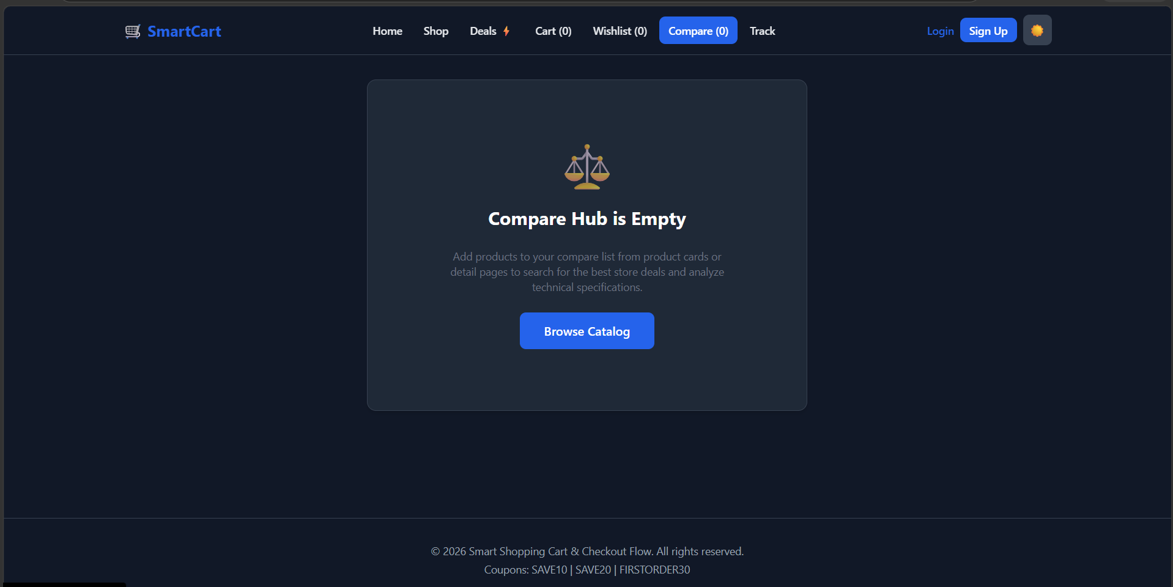
Expected Outcomes of the Proposed Work

Slide 13
Conclusion and Future Scope
Conclusion:
This project delivers a secure, high-performance checkout system by separating frontend user experience from backend business logic. Utilizing React and Express.js, the architecture guarantees a seamless, data-persistent user journey while maintaining total financial integrity. It stands as a robust, scalable template ready for modern, high-stakes e-commerce applications.
Future Scope:
Full Payment Integration: Connect actual payment gateways like Stripe or PayPal to handle real money securely.
Smart AI Discounts: Use basic AI to suggest personalized coupon codes and extra product add-ons at checkout.
Automated Address Checking: Add tools like Google Maps to auto-fill and verify shipping addresses instantly.
Admin Analytics Dashboard: Create a simple tracking dashboard so store owners can see exactly where users drop off and quit the checkout.

Slide 14
References
Some References:
Flanagan, D. (2020). JavaScript: The Definitive Guide. O'Reilly Media.
Relevance: Explains client-side data persistence storage patterns (LocalStorage) and asynchronous data fetching architecture via APIs.
Banks, A., & Porcello, E. (2020). Learning React: Modern Patterns for Developing React Apps. O'Reilly Media.
Relevance: Covers global state management using the React Context API, modular component design, and handling complex multi-step user interfaces.
*Node.js & Express.js Documentation (Official).
Relevance: Serves as the primary reference for building secure, server-side validation layers, managing route structures, and preventing client-side data manipulation in transactional workflows.

Slide 15
Thank you

